Slide 1
Data Engineering
Oksana Tozhovez 07.02.2024

Slide 2
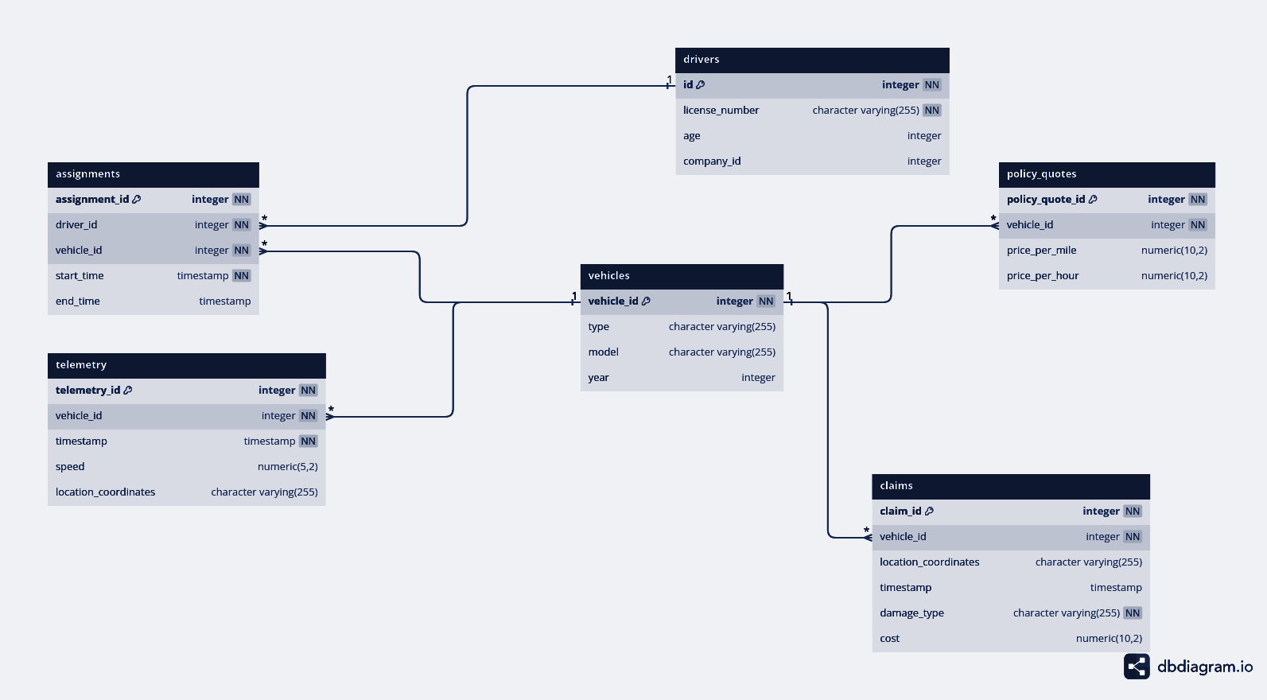
Entity Relationship Diagram

Slide 3
Specify the main fields for each entity
1. Drivers
Primary Field (PK): id Represents a unique identifier for each driver in the database.
Attributes: license_number, age, company_id
Unique: license_number
Relationships:
Drivers to Assignments: One-to-Many (A driver can have multiple assignments).
Entity Relationship Diagram

Slide 4
Specify the main fields for each entity
2. Vehicles
PK: vehicle_id
Attributes: type, model, year
Relationships:
Vehicles to Assignments: One-to-Many (A vehicle can have multiple assignments).
Vehicles to Claims: One-to-Many (A vehicle can have multiple claims against it).
Vehicles to Policy Quotes: One-to-Many (A vehicle can be associated with multiple policy quotes).
Vehicles to Telemetry: One-to-Many (A vehicle can have multiple telemetry records).
Entity Relationship Diagram

Slide 5
Specify the main fields for each entity
3. Assignments
Primary Field (PK): assignment_id Uniquely identifies each assignment record. Assignments link drivers to vehicles for specific periods.
Attributes: start_time, end_time
Foreign Keys (FK):
driver_id (References Drivers)
vehicle_id (References Vehicles)
Unique: driver_id, vehicle_id, start_time
Entity Relationship Diagram

Slide 6
Specify the main fields for each entity
4. Claims
Primary Field (PK): claim_id Uniquely identifies each claim made against a vehicle, usually related to accidents or damages.
Foreign Key (FK):
vehicle_id (References Vehicles)
Attributes: location_coordinates, timestamp, damage_type, cost
Unique: vehicle_id, location_coordinates, timestamp
Entity Relationship Diagram

Slide 7
Specify the main fields for each entity
5. Policy Quotes
Primary Key (PK): policy_quote_id Uniquely identifies each policy quote given to a vehicle, related to insurance or service terms.
Foreign Key (FK):
vehicle_id (References Vehicles)
Attributes: price_per_mile, price_per_hour
Unique: vehicle_id, price_per_mile, price_per_hour
Entity Relationship Diagram

Slide 8
Specify the main fields for each entity
6. Telemetry
Primary Key (PK): telemetry_id Serves as a unique identifier for each telemetry entry, capturing data like speed and location at specific times for vehicles.
Foreign Key (FK):
vehicle_id (References Vehicles)
Attributes: timestamp, speed, location_coordinates
Unique: vehicle_id, timestamp
Entity Relationship Diagram

Slide 9
Specify the main fields for each entity
Primary Fields:
Uniqueness: Each primary field must uniquely identify its respective record in the database. This property ensures that each entity (driver, vehicle, assignment, telemetry record, and claim) can be uniquely and clearly accessed or referenced.
Integrity: Primary fields are integral to enforcing the integrity of the database. They facilitate establishing foreign key relationships. For example, driver_id in the assignments table is a foreign key that references id in the drivers table, establishing a relational link between drivers and their assignments.
Indexes: Primary fields are automatically indexed in PostgreSQL. This indexing speeds up queries and operations that search or filter on the primary key fields, enhancing overall database performance.

Slide 10
Specify primary and foreign keys, and specify cardinality (one-to-one, one-to-many, many-to-many)
Cardinality:
Drivers to Assignments: One-to-Many
One driver can have multiple assignments.
Vehicles to Assignments: One-to-Many
One vehicle can be part of multiple assignments.
Vehicles to Claims: One-to-Many
One vehicle can have multiple claims filed against it.
Vehicles to Policy Quotes: One-to-Many
One vehicle can be associated with multiple policy quotes over time.
Vehicles to Telemetry: One-to-Many
One vehicle can generate multiple telemetry records during its operation.

Slide 11
Specify primary and foreign keys, and specify cardinality (one-to-one, one-to-many, many-to-many)
Summary of Cardinalities:
One-to-Many (1:N): This relationship exists when a single entity (on the "one" side) is linked to multiple records of another entity (on the "many" side). In this schema, a vehicle is associated with many assignments, claims, policy quotes, and telemetry records, signifying one-to-many relationships.
Many-to-One (N:1): The inverse of the one-to-many relationship. Many assignments, claims, telemetry records, or policy quotes can be related to one vehicle. Similarly, many assignments are related to one driver.

Slide 12
Suggest a pipeline architecture for bringing the data from its source to our internal consumers
1. Data Ingestion Layer
Source: CSV files hosted on an SFTP server.
Tool: A scheduler (e.g., Apache Airflow) triggers Python scripts to connect to the SFTP server, download the CSV files, and perform initial data validation.
Process: The Python scripts use libraries like paramiko for SFTP connection and pandas for initial data manipulation.
2. Data Storage Layer
Storage: PostgreSQL Database.
Process:
Upon successful data retrieval and initial processing, data is staged into a landing zone in PostgreSQL using INSERT commands.
Use a schema that supports the datasets: Drivers, Assignments, Telemetry, and Claims, ensuring proper relational integrity and indexes for performance.

Slide 13
Suggest a pipeline architecture for bringing the data from its source to our internal consumers
3. Data Transformation and Processing Layer
Tools: Apache Airflow for orchestrating ETL (Extract, Transform, Load) jobs.
Process:
Transform: Within the PostgreSQL environment or using external tools like dbt (Data Build Tool), transform the data to match business requirements (convert coordinates, aggregate data, calculate metrics like miles/duration driven).
Cleanse and Validate: Ensure the data quality is up to the mark, handling anomalies or missing values.
Load: Load the processed data into a separate schema or database optimized for querying and reporting.
4. Data Presentation Layer
Tools: Business Intelligence tools (e.g., Tableau, Power BI, Metabase) connected directly to the PostgreSQL database.
Process: Custom dashboards and reports are built on top of the transformed data, enabling internal consumers to access insights and KPIs directly.

Slide 14
Suggest a pipeline architecture for bringing the data from its source to our internal consumers
5. Data Orchestration and Monitoring
Tools: Apache Airflow for managing the pipeline workflow, scheduling jobs, and error handling.
Monitoring: Incorporate logging and monitoring (e.g., using Prometheus, Grafana) for pipeline components to ensure operational health and timely data availability.
6. Data Update and Maintenance
Process:
1. Daily updates are managed through the scheduler (Apache Airflow), ensuring new data files are fetched, processed, and loaded into the database.
2. Implement data retention policies and archive old data to maintain performance and manage storage costs.

Slide 15
Suggest a pipeline architecture for bringing the data from its source to our internal consumers
Conclusion
This pipeline architecture leverages modern tools and practices for building a reliable and scalable data pipeline.
It supports the business requirements by enabling efficient data management, daily updates, and providing insights through reports and dashboards to internal consumers.
The orchestration capabilities of Apache Airflow, combined with the storage and querying capabilities of PostgreSQL, provide a solid foundation to fulfill the diverse needs of the transportation company.

Slide 16
Data Engineering
Thank you for your time and consideration.
Oksana Tozhovez 07.02.2024

